Slide 1
Multi-Object Tracking on KITTI
-Riddhesh Shah

Slide 2
The Task and Associated Problems
Detect and track objects to interpret scene dynamics.
Requires association of each detection’s respective “tracks”
Detections in Image space offers a larger sensing range with high precision, but lower recall.
Detections using 3D lidar readings offer higher recall but lower precision and sensing range.
Need a robust process to match detections between frames and rule whether to keep of discard its track

Slide 3
Method: EagerMOT (Kim et al.)
Object detection in 2D and 3D spaces followed by the fusion of these detections based on 2D overlap
Fused instances then go through a two staged matching process to update their tracks using 3D and/or 2D information
An object’s track lifecycle is determined by a set of simple rules to determine whether to keep or discard an object’s track.

Slide 4
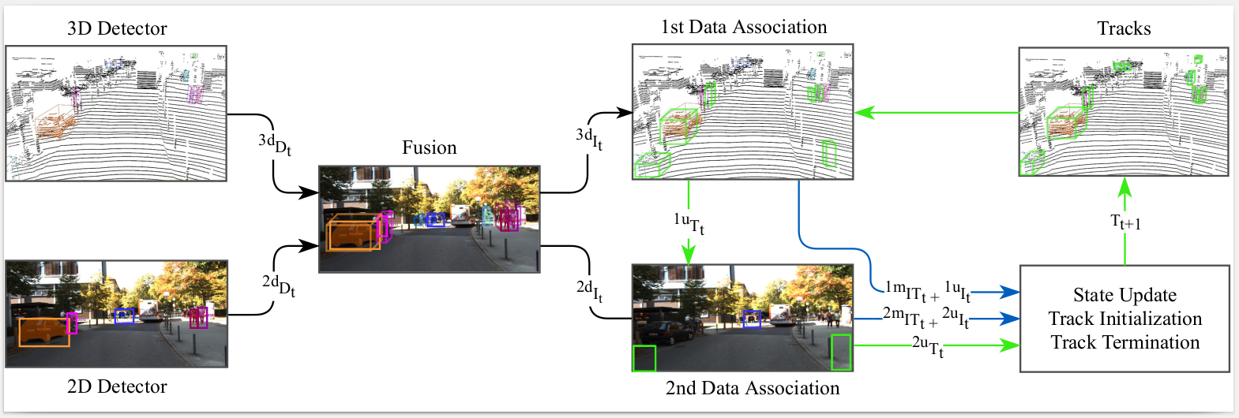
EagerMOT (Kim et al.)

Slide 5
Object Detection

Slide 6
EagerMOT: Detection Stage
3D Detections: PointGNN encodes point clouds in a fixed radius nearest neighbours graph. Combines detections of multiple vertices. Performs better than many fusion methods.
2D Detections: MOTSFusion (RRC)+TrackRCNN. RRC offers reconstruction based detections trained for purposes of object tracking. TrackRCNN is a basic RCNN based approach. RRC detections are used for cars while trackRCNN for pedestrians

Slide 7
Detection Fusion

Slide 8
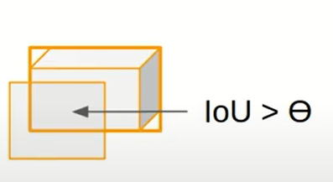

Detection Fusion
Trace over overlapping detections

Slide 9
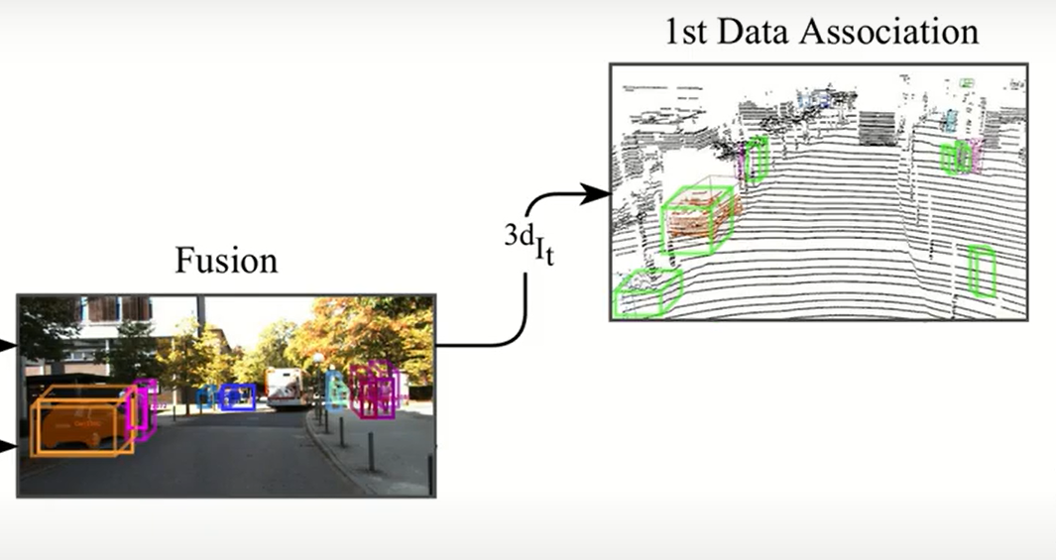
Data Association (1st Stage)

Slide 10
Data Association (1st Step)
7D State Parametrization: [x, y, z, h, w, l, Ө]
Match instances detected in 3D with existing tracks using track 3D state information.
greedily pair detected instances 3d It with tracks 3dTt based on the scaled distance between instances’ oriented bounding boxes and tracks’ predicted oriented boxes
Scaled distance: Euclidean distance between bounding boxes * cos_dist(orientation_vectors)
More robust than 3D IoU

Slide 11
Data Association (2nd Stage)

Slide 12
Data Association (2nd Step)
Take unmatched tracks from the first stage and match detected instances to tracks in the 2D image domain.
Helps include occluded portions that the lidar may not have picked up on.
Done by greedily pairing matches based on 2D IoU
Extra-chance for a track to remain alive

Slide 13
State Update and Looping Iteration

Slide 14
State Update and Looping Iteration
Update state variables using a Kalman filter
Initialize new tracks based on new 3D+2D detections
Kill old tracks if not associated in either stage of the data association stages.
Killing and initializing tracks can be adjusted to trigger based on frequency based thresholds.

Slide 15
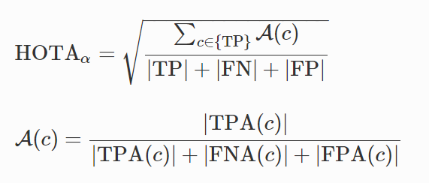
Evaluation Metric: HOTA
Matching Predictions and Ground-Truth
Measuring Association
Scoring Function

Slide 16
Results
Method | Car (HOTA) | Pedestrian (HOTA)
KITTI (RRC+MOTSFusion+Point-GNN) | 74.39 | 46.30
MOTSFusion | 68.74 | -
3D-TSLR | - | 46.34
CenterTrack (2D only) | 73.02 | 40.35

